Slide 1
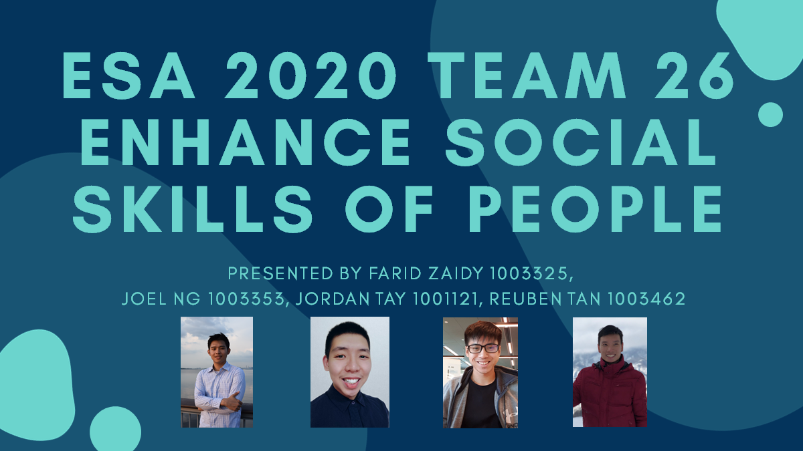
Title Slide
Notes:
Good Afternoon Profs and Friends, today Team 26 is going to present a game that would improve your social skills.
My team consist of Zaidy, Joel, Reuben and Me

Slide 2
Design Concept ~ The Game
Notes:
So firstly we would introduce to you our Design Concept and then our design journey

Slide 3
Design concept
Motivation
Game Overview
Learning & Winning Objective
Rules
Board: Titles
Cards: 4 Card Types
R shiny App: Demo of Score Counter and Timer
Notes:
In our design concept, would introduce to you our motivation for creating such a game and the followed by our game overview.

Slide 4
Design concept: Motivation
“We wish to impart knowledge of different possible social scenarios involving professional roles and different nationalities.
When Players social skills are enhanced, we would achieve our goal of improving their social skills.”
- ESA 2020 Team 26
Notes:
Our motivation for creating such a game is to impart knowledge of different possible social scenarios ranging from professional roles and different nationalities.
By playing our game, the players would enhance their social skills
allow us of achieving our goal of improving their social skills.

Slide 5
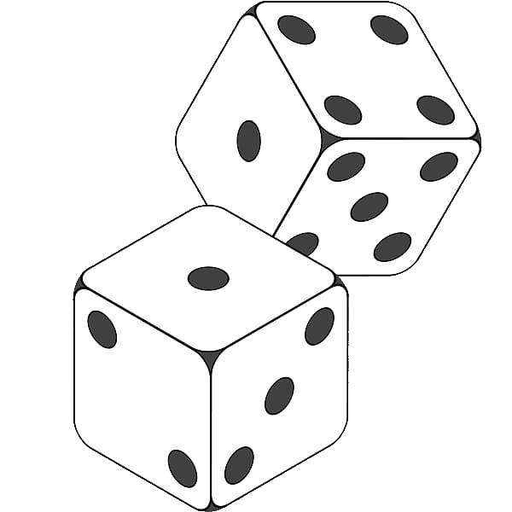
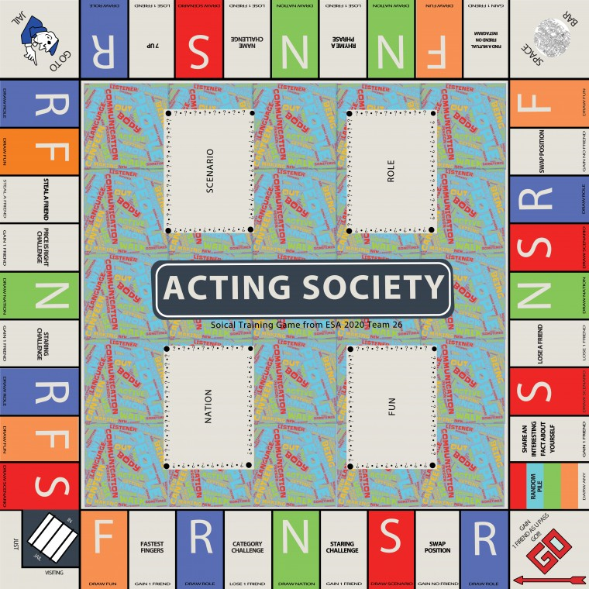
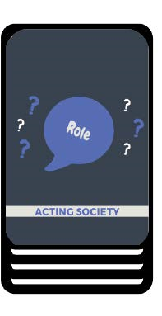
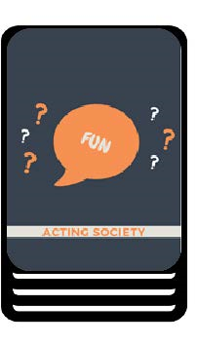

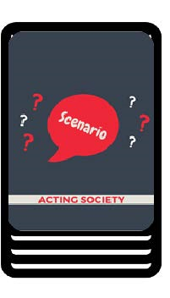
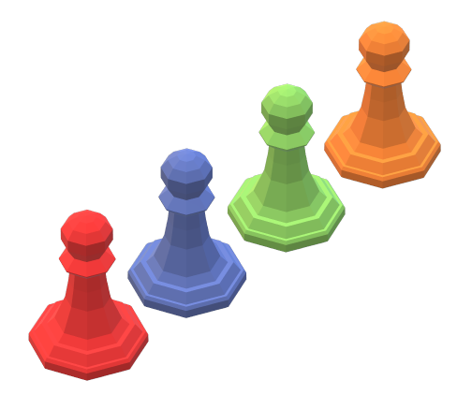
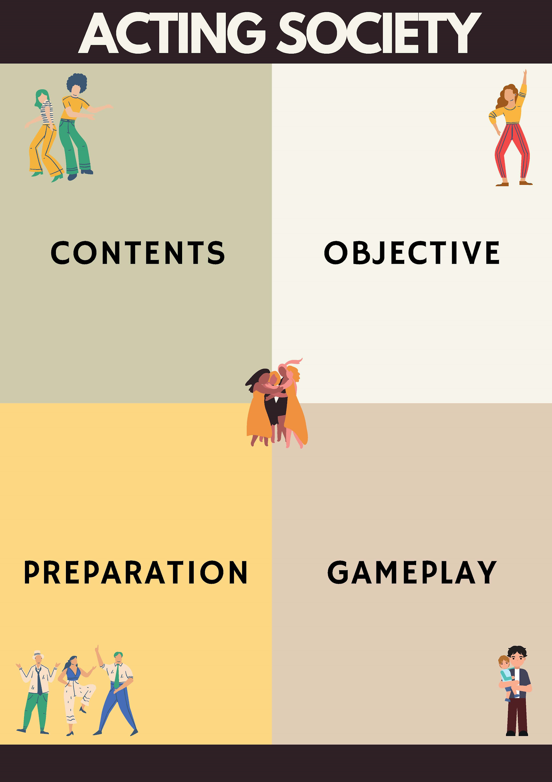
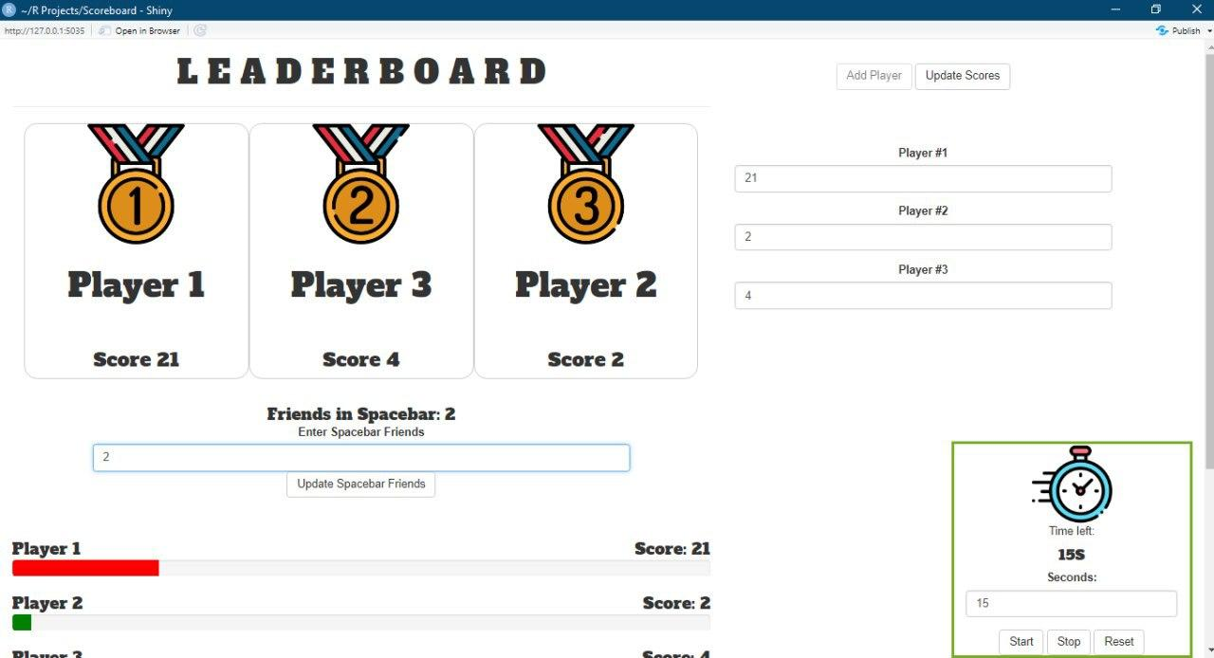
Design concept: Game Overview
The ACTING SOCIETY
X 1 Set of 2 Dices
X 4 Player Tokens
X 15 Each Pile
X 1 R Shiny App
X 1 Rule Book
Notes:
So this is an overview of what our game would consist of,
a board,4 different types of acting cards piles, dices, player token, rule book and R Shiny App.

Slide 6
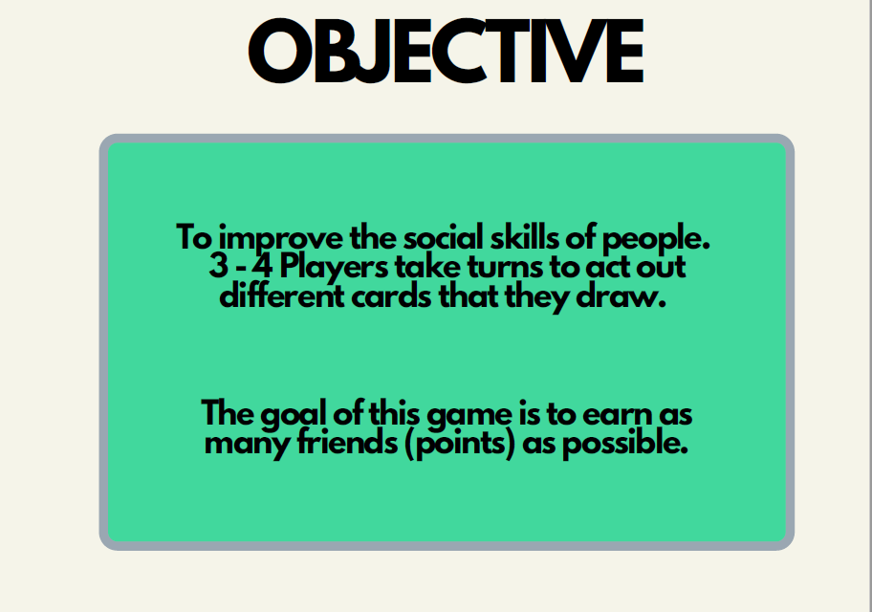
Design concept: Objective
The ACTING SOCIETY
Notes:
So for the objective for this game is improve the social skills via acting which is similar to a game of charades.
Limited to 3 to 4 players age 20 ~25
Where the goal is to earn as many friends(pts) as possible

Slide 7
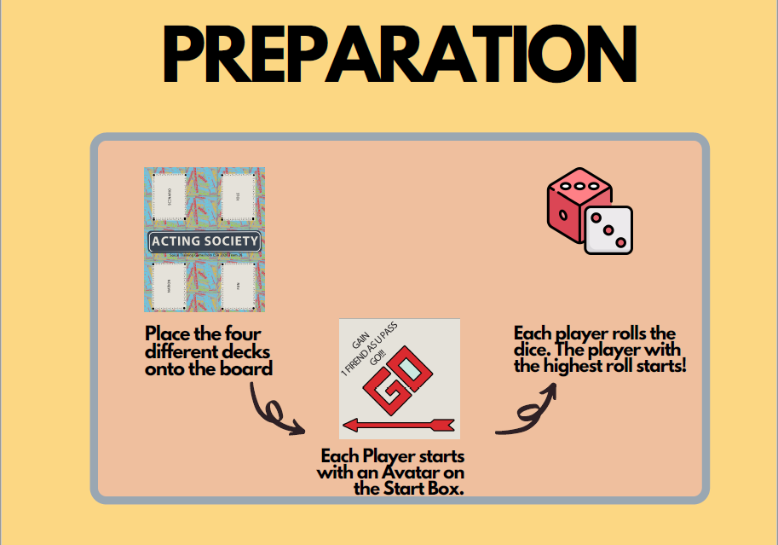
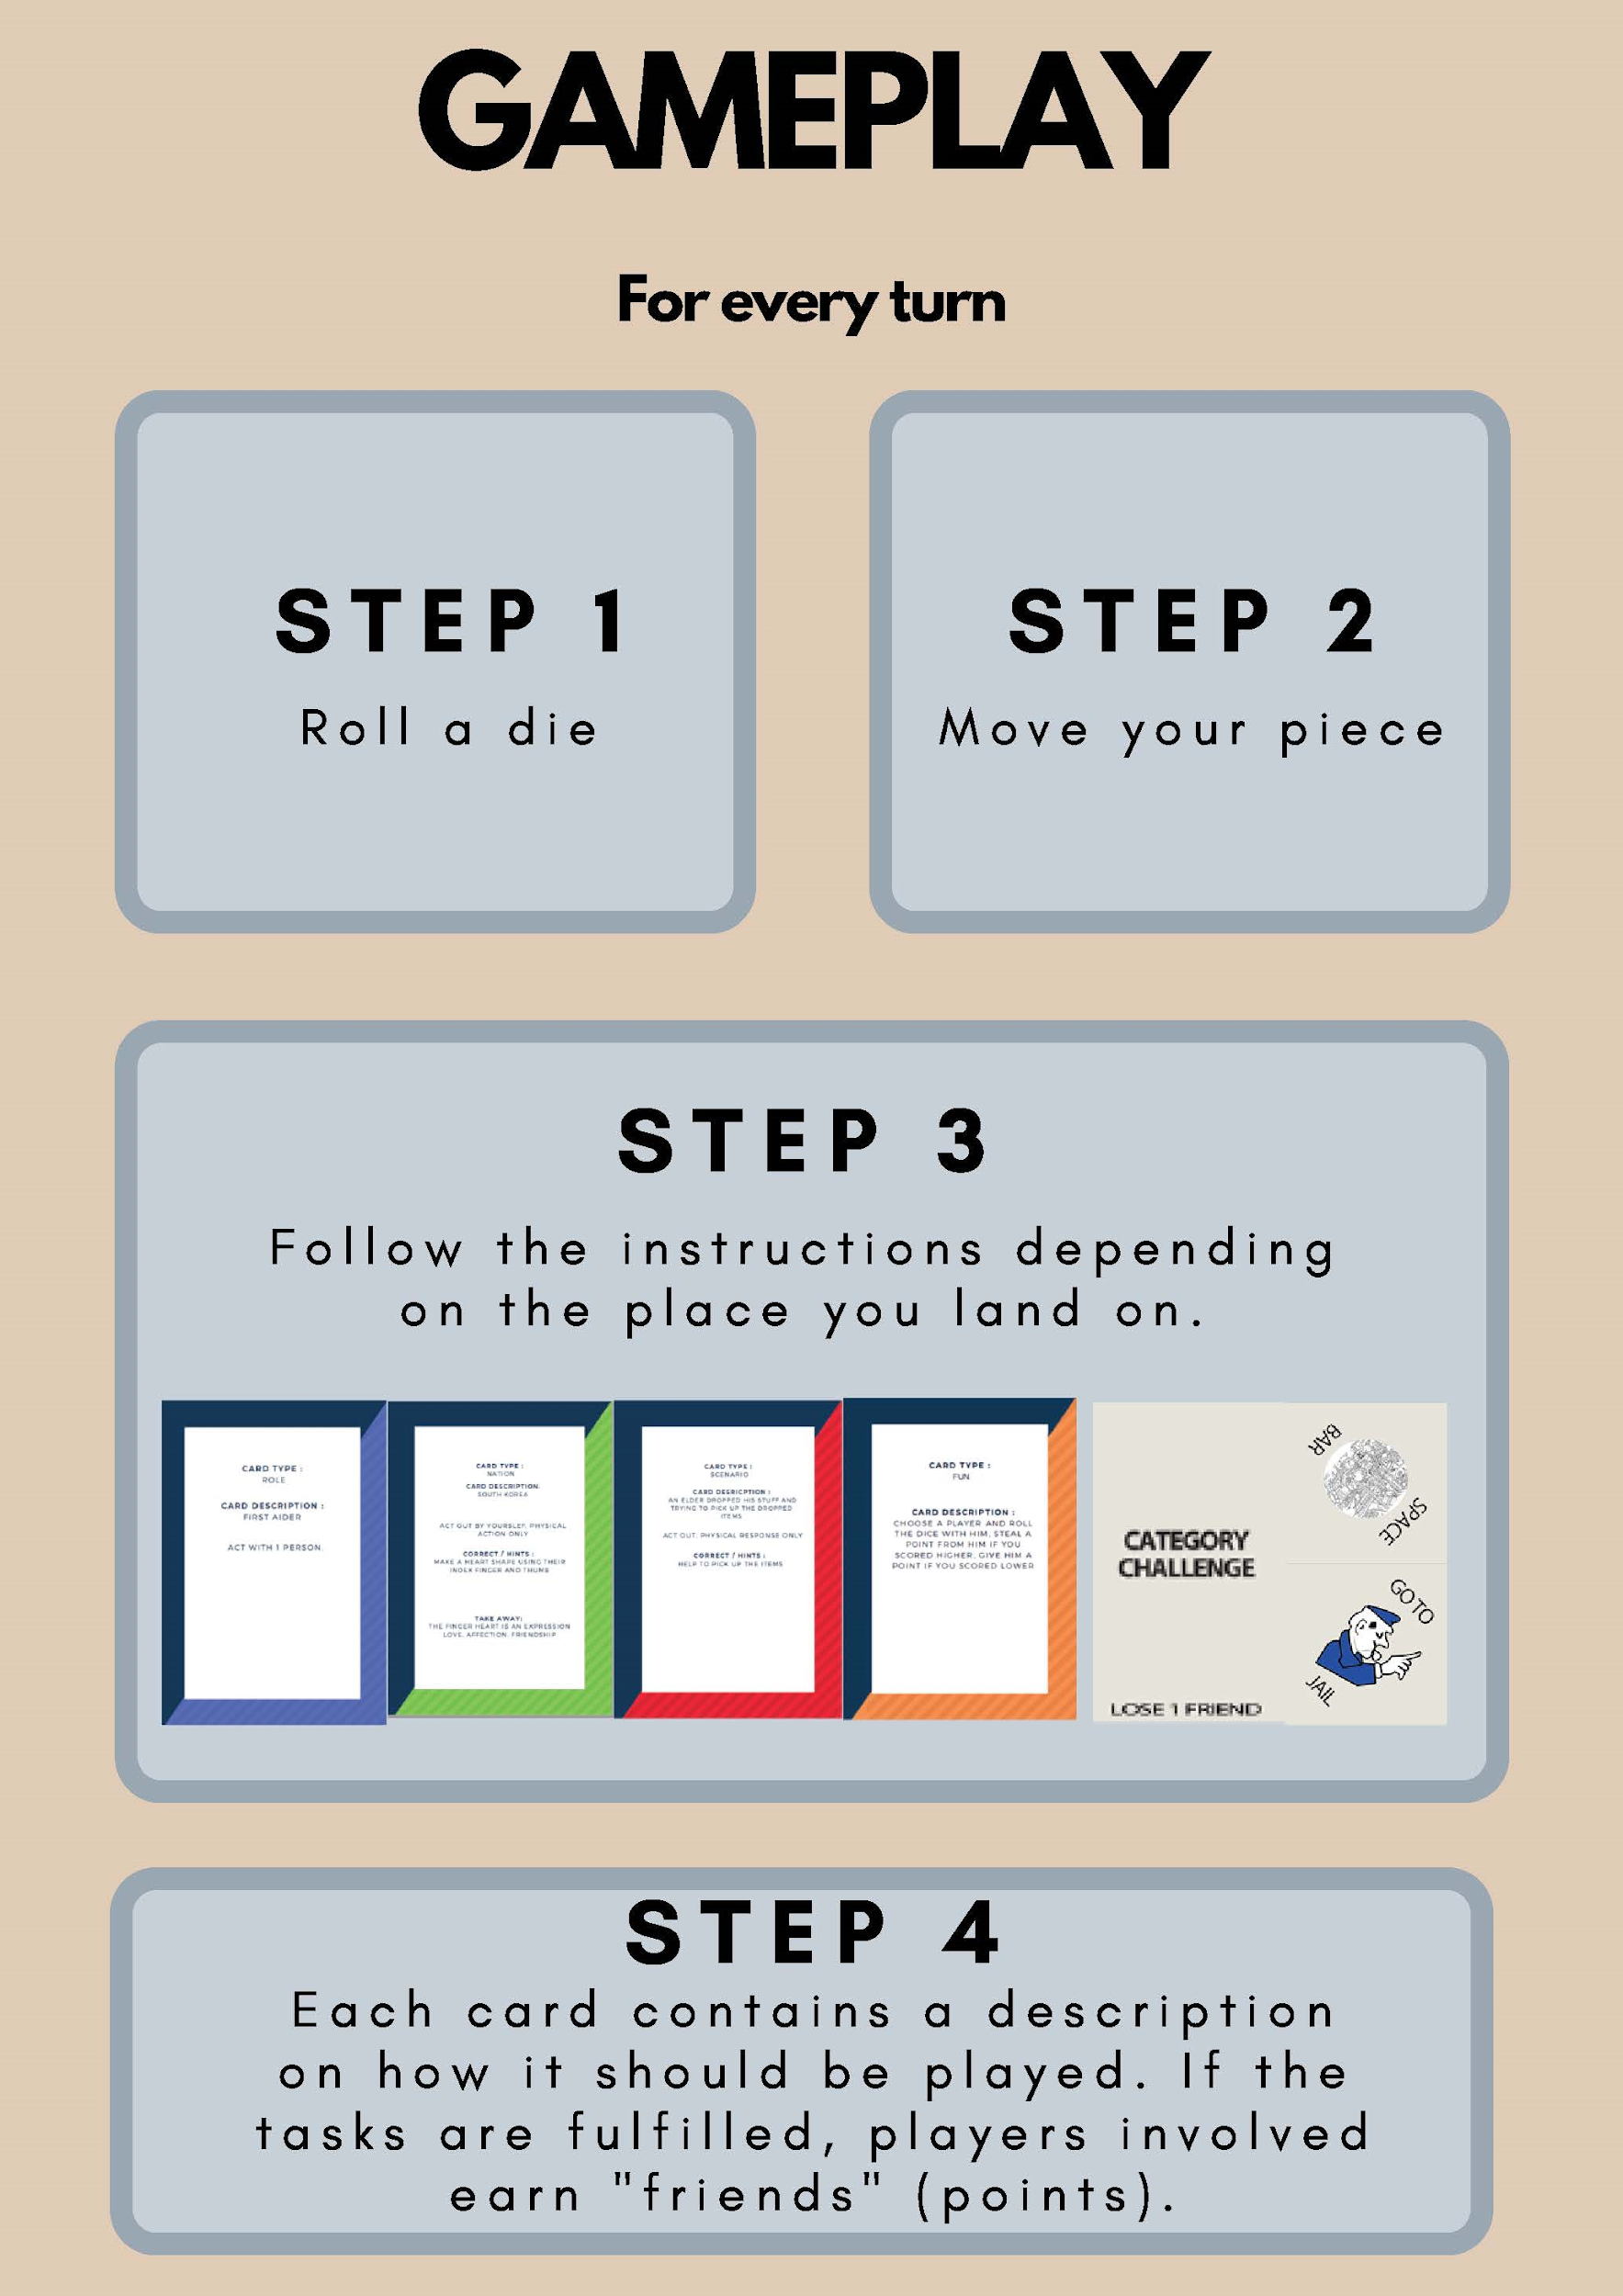
Design concept: GamePlay & Rules
The ACTING SOCIETY
Notes:
Next would be the gameplay and rules,
To start, we place the 4 different card piles onto the board with all player token starting at the Go sign
Then all will roll a dice and the one with the highest dice roll will go 1st
Next The gameplay flow for all player would be same where they would roll the dice and move according to the dice roll.
Then they would follow the instruction on the title they landed on
They would either draw an acting card and follow the card instructions
or they would do a title activity
Lastly the point would be adjust on the R shiny app if there are changes in the amount of friends

Slide 8
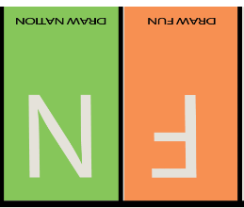
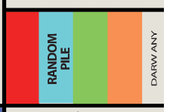
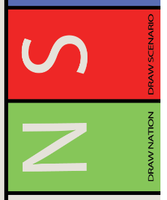
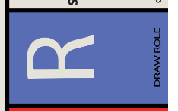
Design concept: Card Titles
The ACTING SOCIETY
Notes:
These are titles which would prome the player to draw from the respective card pile such as Scenario, Role, Nation and Fun

Slide 9
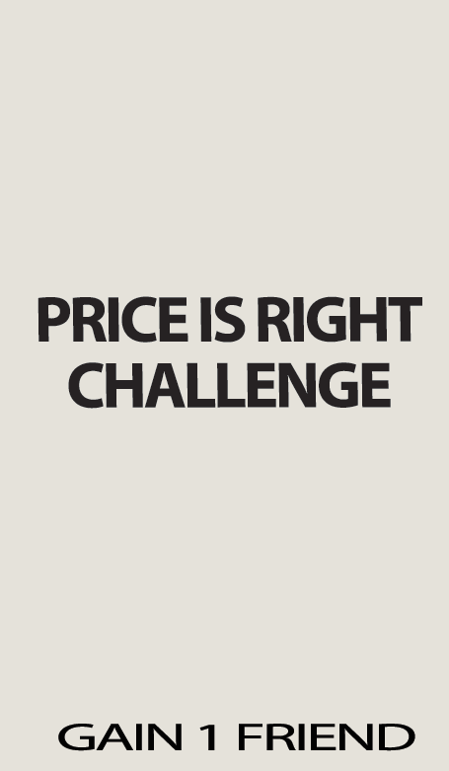
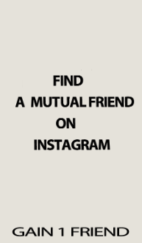
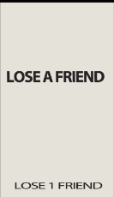
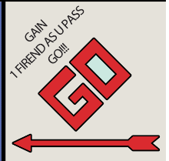
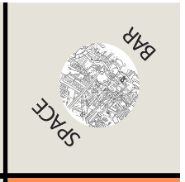
Design concept: Activities & Others Titles
The ACTING SOCIETY
Notes:
These are the other titles where there are detailed explanation in our rule book
Now I'm going to show a video of our game play, enjoy.
Hope you games enjoy the video, Next Zadiy would be explaining more on on the 4 different types of cards and our R shiny app. Zadiy Pls
Titles with activities for example lose a friend title
And other special titles such as Go where we start our game or we would gain a friend when we pass it
Space bar is where all the lost friend are stored and any player who lands on it would gain the lose friend that are currently in the space bar
The Go to Jail is as what it says
Lastly this is jail title, which store all the players who landed on the GO to jail title with the same concept as monoploy
where the only escape is to roll a double before 3 turns or wait for 3 turns and lose a friend

Slide 10
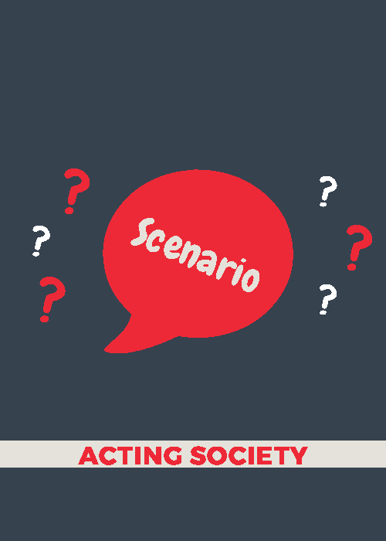
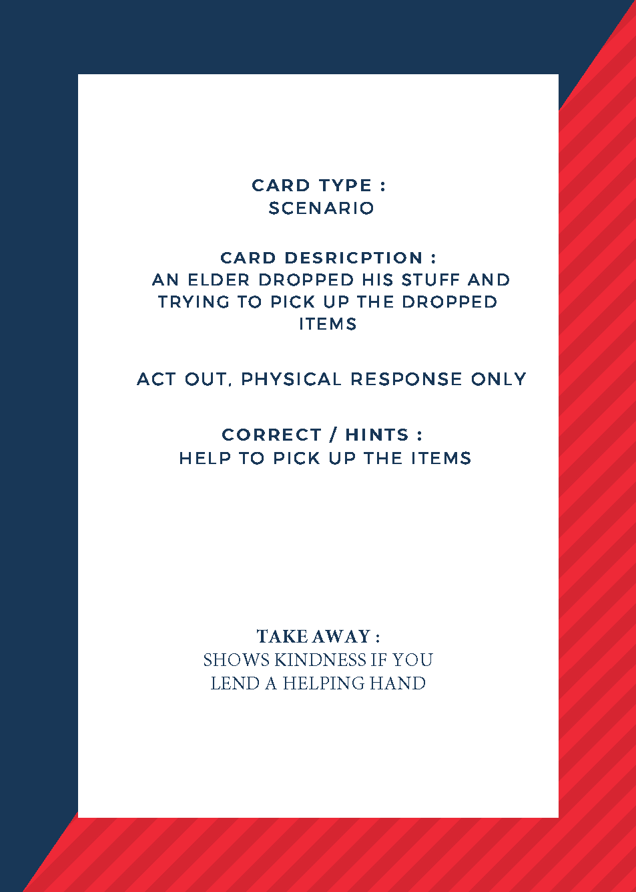
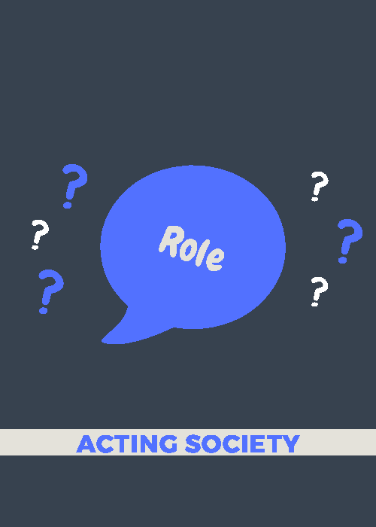
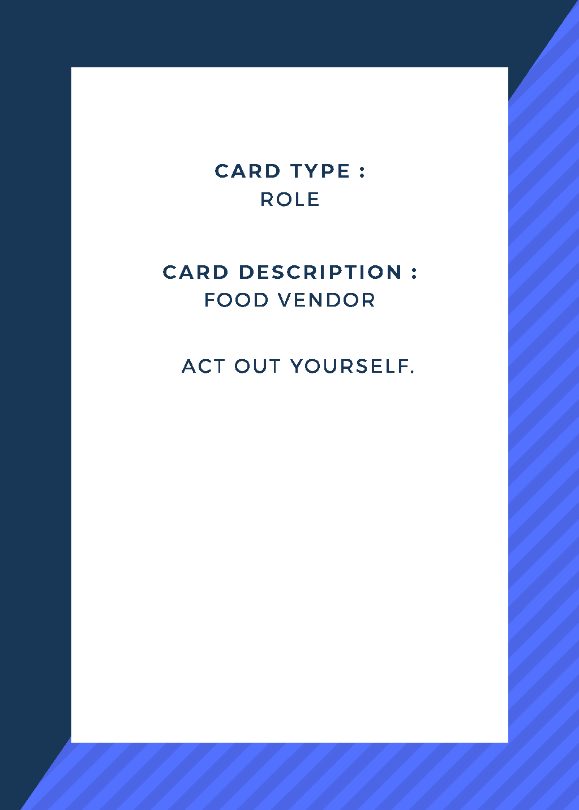
Design concept: Cards
The ACTING SOCIETY
Notes:
Focus on this part how it manage to make us obtain our goal
Don’t say social recommend that way, advisable way
So we have 4 different type of cards which each having to explain a difference goal
All cards would go by this format of Card type, card description and take away for scenario and nation cards
This way it would be able to enhance the social skills and knowledge of our players obtaining our goal.
For example the scenario card would give a case if an elder dropped his stuff
Hence, the player who drew the card is suppose to tell tell the others that he would be acting out and the other players would have to give a physical response
So after explanation, the timer on the r shiny would start and the other players would need to guess by giving a physical response within the time limit.
Also for this scenario example there is a take away or a recommended answer for to determine who gets the point
However the beauty of this teaching social skills or knowledge is there are no right ans. If the other player response is to pick up the items and carry the items for the elderly the other player can learn from this extra action and next time help other in this way.
Moreover, at the end of the game, we would encourage the actor play to provide insight and read out the takeaway from the card to improve the knowledge of the other players as well.
For example the nation card would for this example would explain what a finger heart in south korea represent which is an Expression of love, affection and friendship.

Slide 11

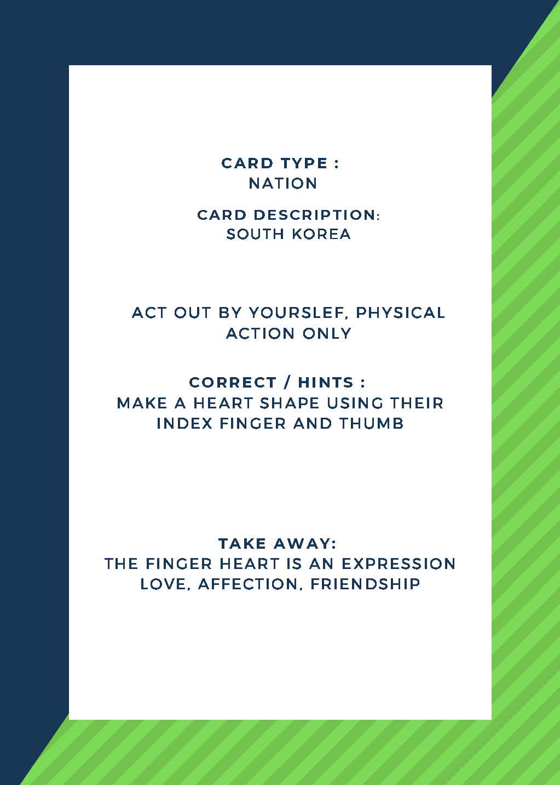
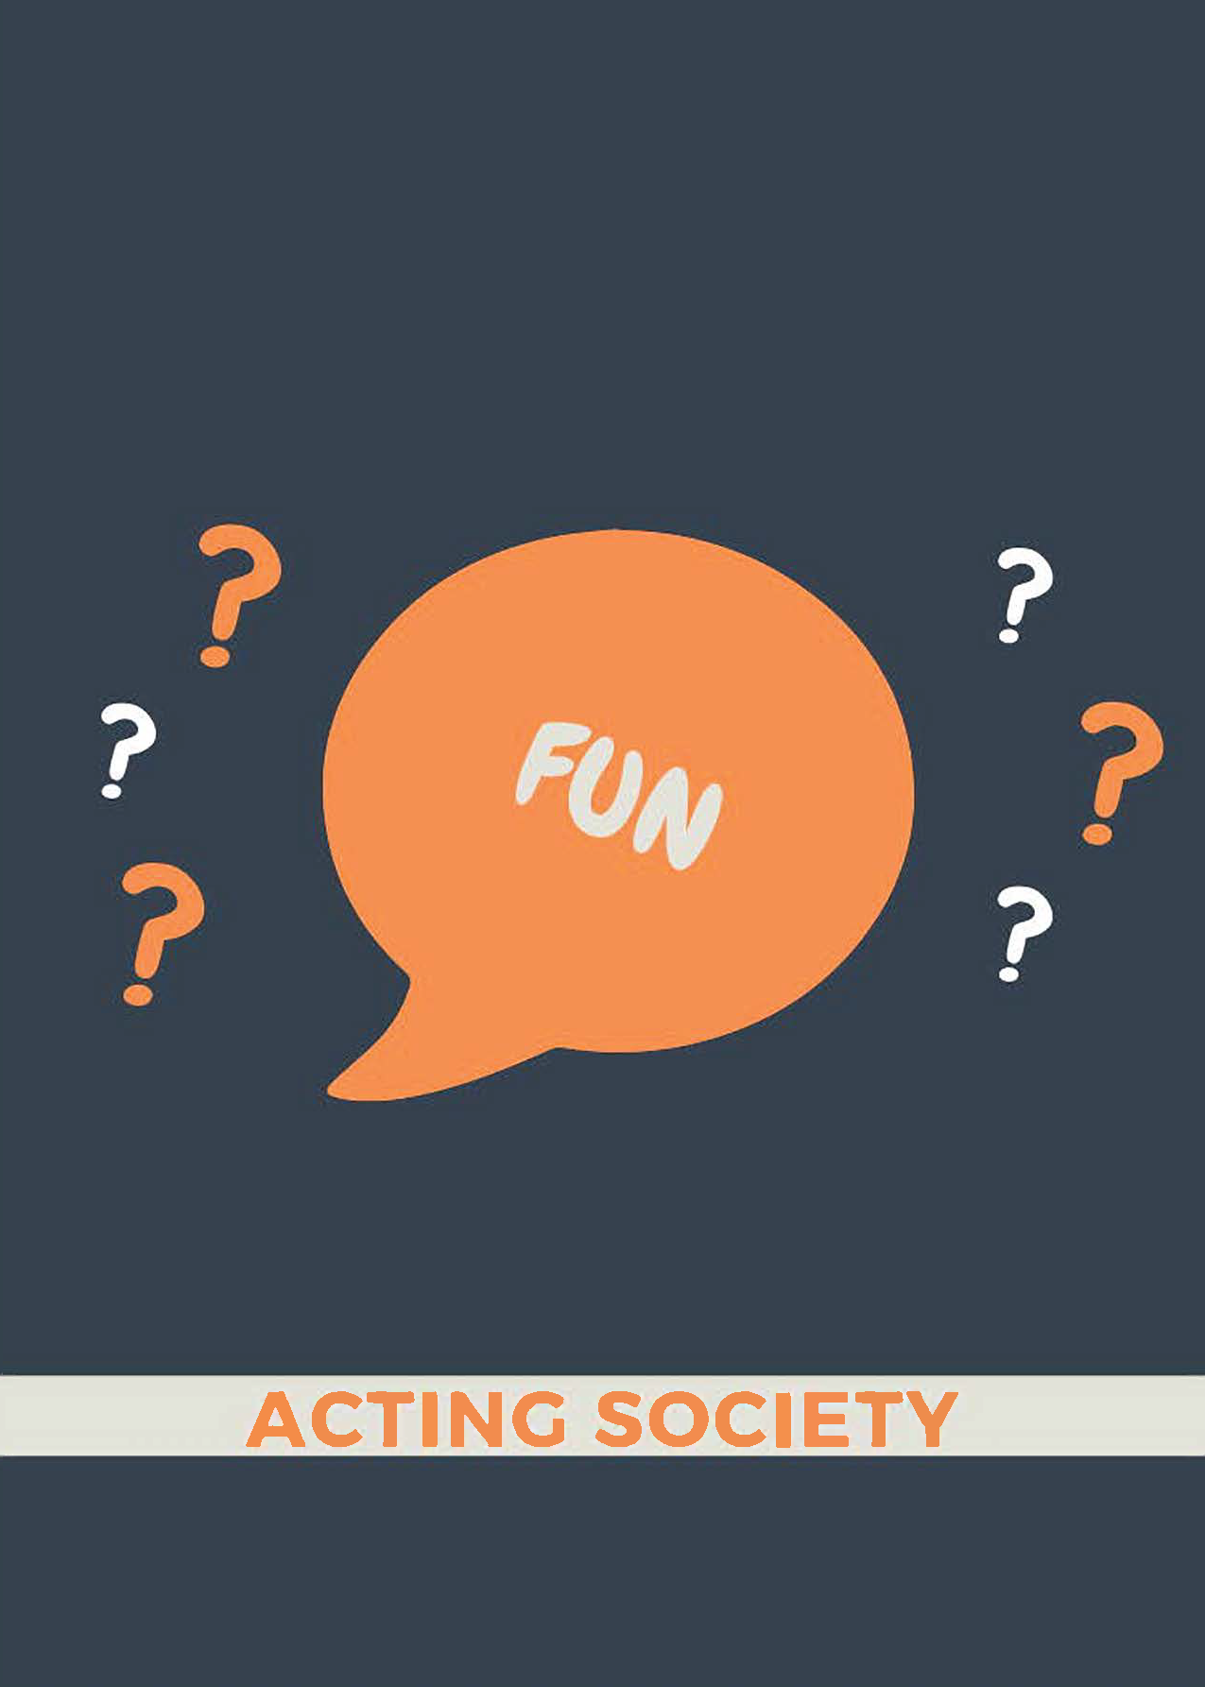
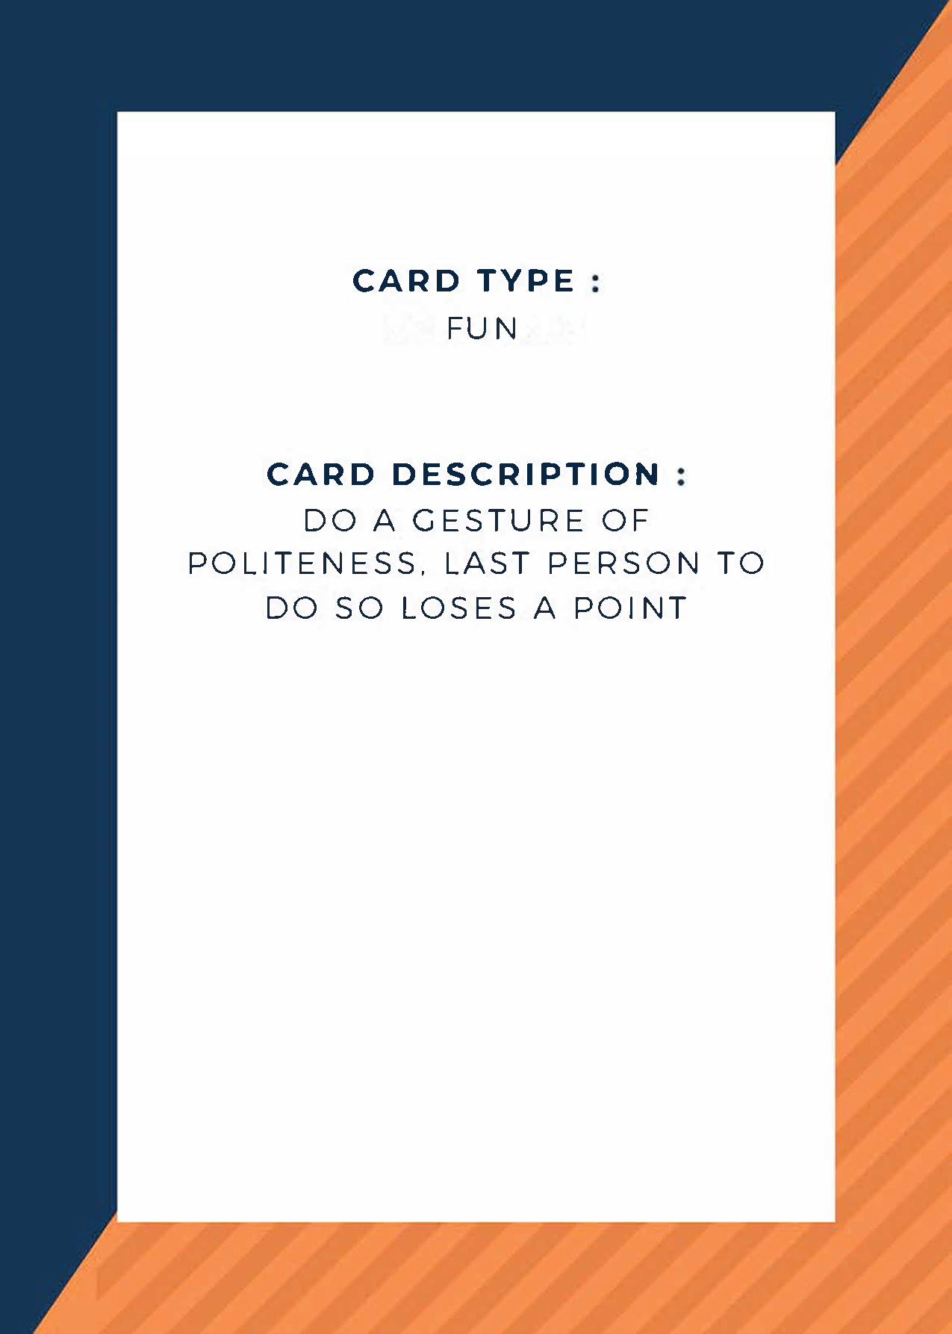
Design concept: Cards
The ACTING SOCIETY
Notes:
Focus on this part how it manage to make us obtain our goal

Slide 12
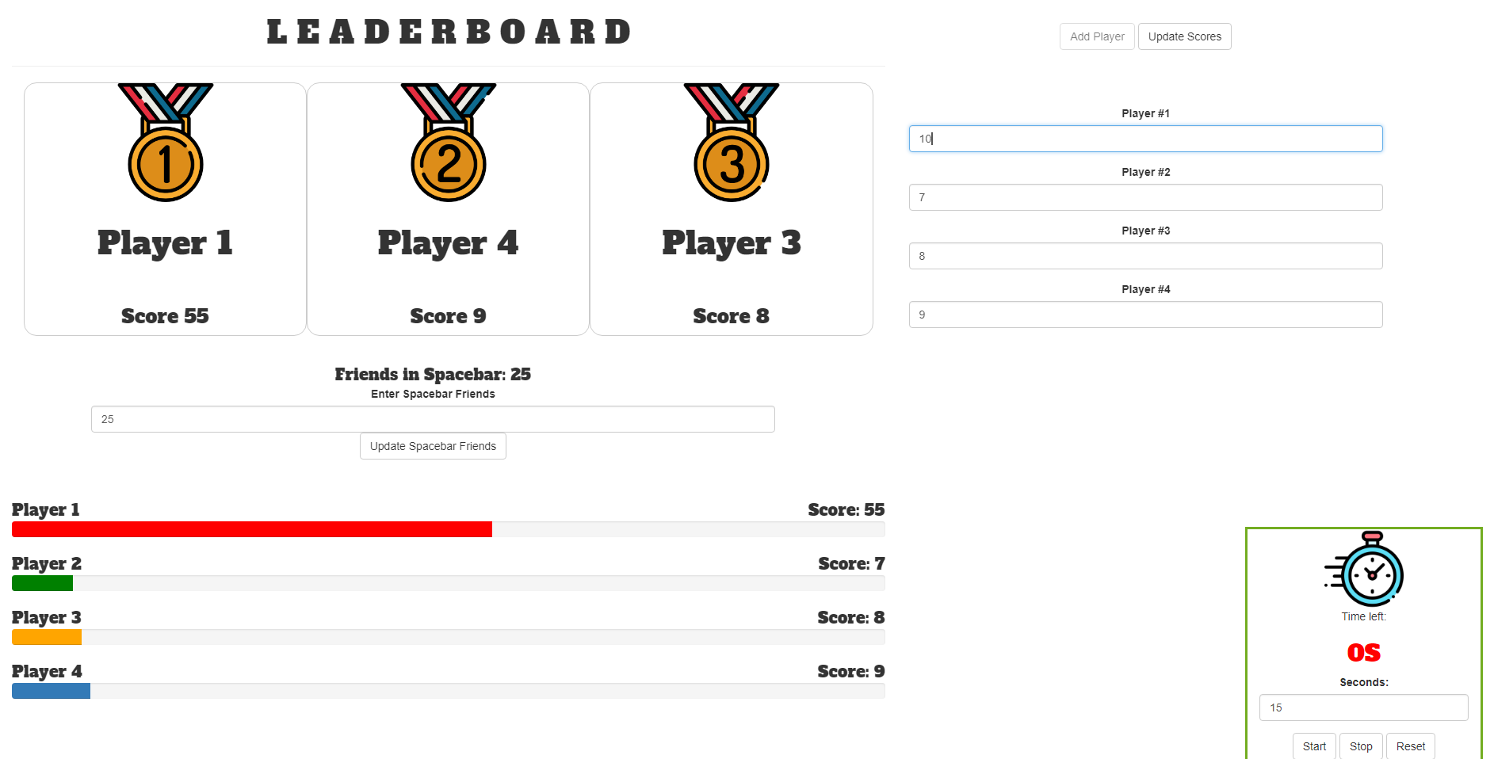
Design concept: R Shiny APP
The ACTING SOCIETY
Notes:
Demo R Shiny

Slide 13
The Journey
Notes:
Thank you Zaidy

Slide 14
The Journey
Initial planning
Mission Statement
Key Consideration from Survey
The initial concept selection & Finalize concept layout
Design and Prototyping Phase
Major decision of the phase
The difference between System definition Phase and Detailed Design & Prototyping Phase
Initial prototyping
improvement
Reflection
Notes:
To create and materialize a design concept, there are 2 phases that we would need to get through.
the Conceptualization and subsequently the development phase

Slide 15
Initial planning: Development Phase
The Mission Statement
Improve Students social skills
Impart knowledge and Skills on social interaction
Covering Professional behavior to Ethics of different countries
Notes:
Our Mission was to design an entertaining and novel hands-on game to simulate social interaction between young students
By Providing different social scenarios
which in turn enhance their social skills

Slide 16
Development Phase: Key Consideration from Survey
Survey: key considerations
Applicability to real life
Wow Factor
Playability ( Ease of learning to play )
Skills to improvement sociability
Notes:
Based on our survey, these key considerations surfaced…
and the heaviest weight was the Social Skills improvement.
These concerns acted as guidelines in developing our design concept

Slide 17
Major design decisions
Physical Board game with cards: More hands on and interactive
Multi-player: Increased the game’s replayability
Acting game: Something that is different and unique
Competitive and collaborative: Makes the game less mundane and more exciting
Notes:
Overall These are our main design decisions through the course of the project… Which was to design a physical board and card game, that could be played by many players. We also decided that it should involve acting, and be competive and collaborative at the same time!

Slide 18
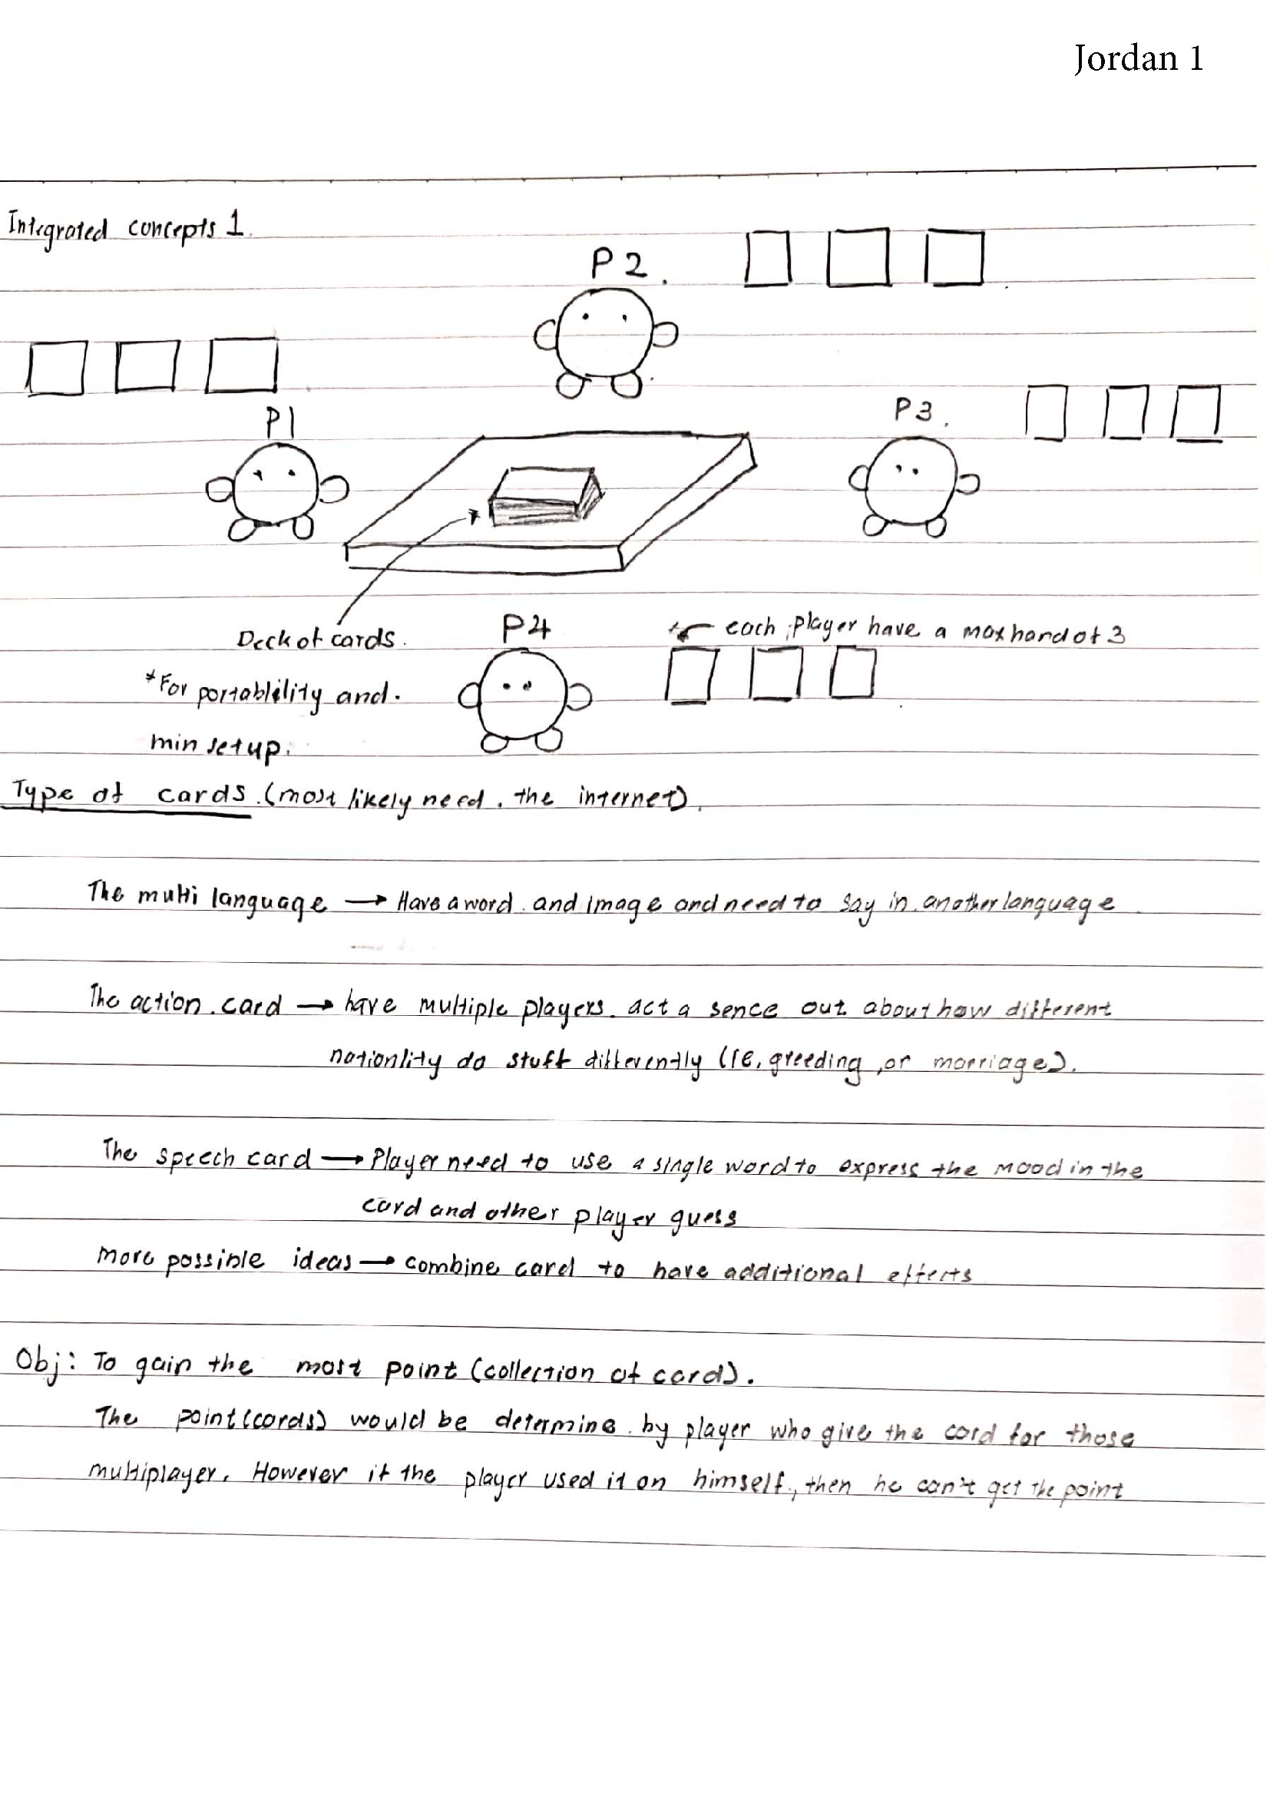
Conceptualization Phase : Initial concept selection
Jordan 1 selected
4 Player Card Game
Area to improve:
Fun factor
Goal of activity unclear
Biases
Choosing player of choice
Notes:
Using our guidelines from the survey,
We were able to come up with the design concept as a 4-player card game.
However, there were still areas to improve on:
The fun factor was lacking as it one dimensional, the cards drawn are the deciding factor as to who wins
The goal of each activity were also unclear as we did not state the learning objectives
There were also Biases in point allocation

Slide 19
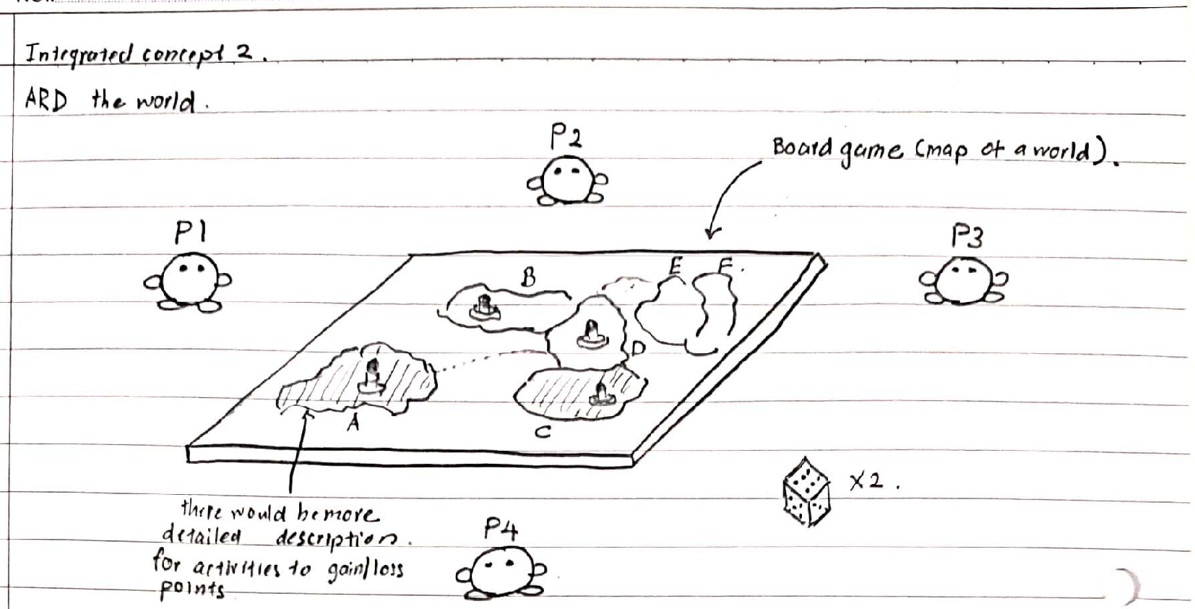
Conceptualization Phase : Initial concept selection
X
Notes:
Hence, to reduce these issues we combine our idea another concept with clearer objectives, greater interaction, and fairer allocation
After further discussions we decided to adopt the main aspects of Jordan 1 and merge it with Jordan 2.

Slide 20
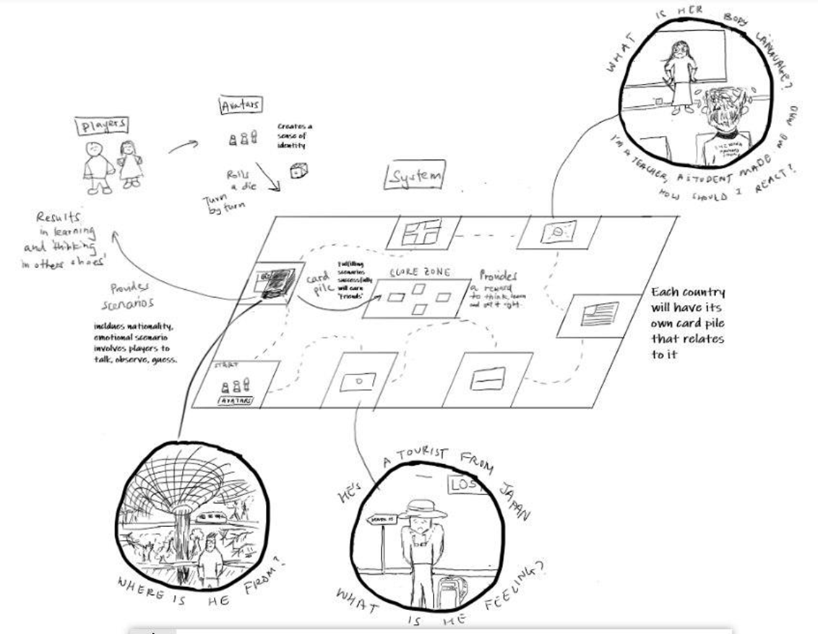
Conceptualization Phase: Finalize Concept Layout
The Concept sketch
Improvements
Improvement of fun aspect
More dimensions
Board
Reduce Biases
Random Rolls
Clearer goal of each activity
Teaching the social aspect of the country
Notes:
After integrating our two concepts to fit our design objective space, we have our finalized concept layout Which retains the simplicity in implementation and enhances our gameplay by adding another dimension to the game
It would also reduce the biases in allocating activities and show clearer objectives as now players would need to travel to a room which would provide activities based on the country represented
I will now pass my time to Reuben who will bring you through the Decisions made in the prototyping phase

Slide 21
Prototyping Phase
Notes:
Thank you Joel. I’ll now go through the process of our prototyping phase.

Slide 22
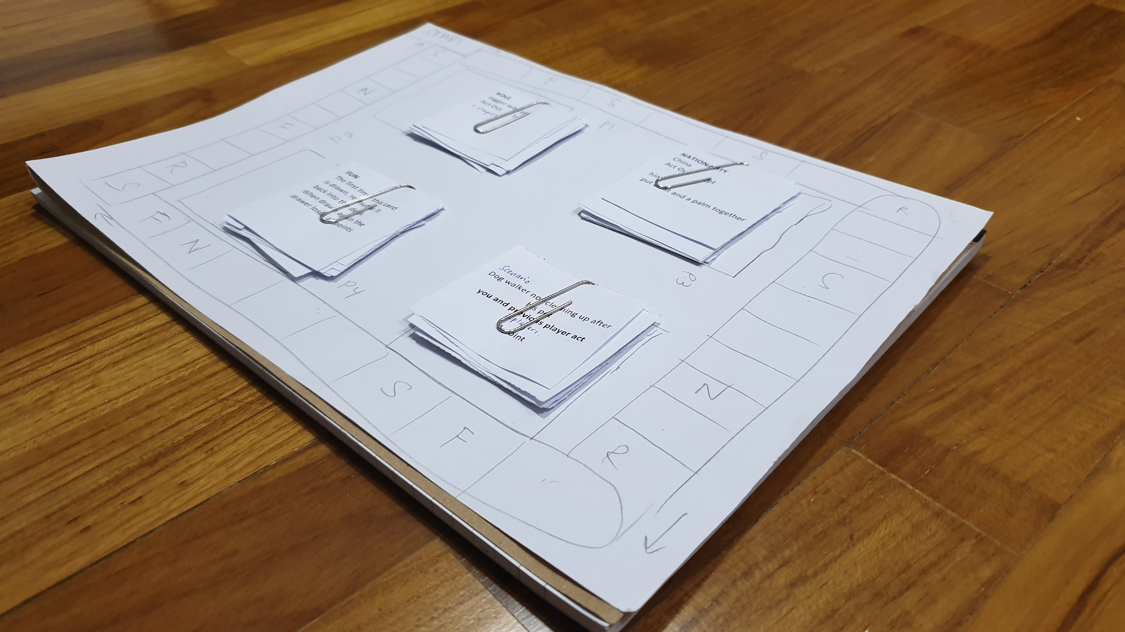
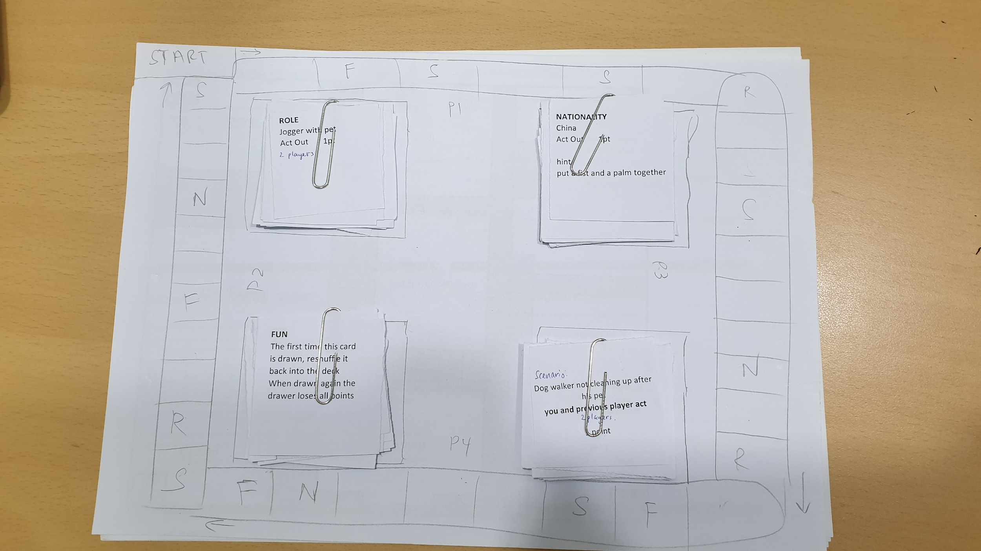
Modal Transitions and modifications
Notes:
As you can see, this was our first prototype of our game. In our modal analysis as well as insights from testing our game, we set up regulatory rules and formatted our card details to ensure smooth modal transition. When we first put together a prototype, we thought it would be a smooth process playing the game. However, we forgot to take into account of our prior knowledge of making the game.
For example, one of the problems we ran into was the transition of a player’s turn to another. A Player could take forever to get his point and make the game too long. We then decided to add in a time limit in our rshiny to regulate the mode transition

Slide 23
Modal Transitions and modifications
Notes:
This was our final board design which included more activities for player to take part in and more aesthetically looking

Slide 24
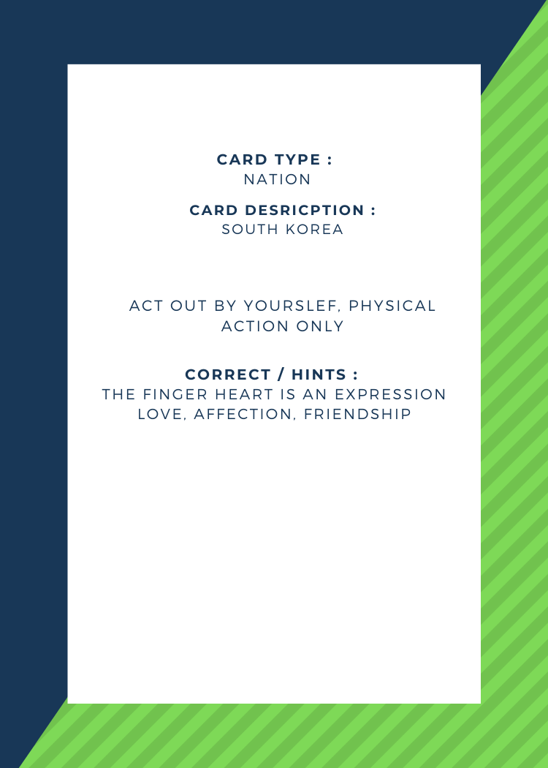
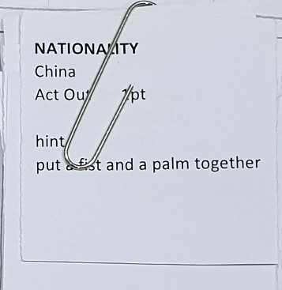
Prototyping of our cards
Notes:
This was our prototype of our cards. The first card on the left was our first prototype. It was basic and simple in design with minimum description. However, it was too plain to our users
Thus, we decided to make our cards look neater by having headers on it. It looked way better than our previous design and more suitable for our players.
However, we wanted to further emphasise the educational value that each card brings. Thus we added in another header called takeaway which allows users to understand what the card is teaching them.

Slide 25
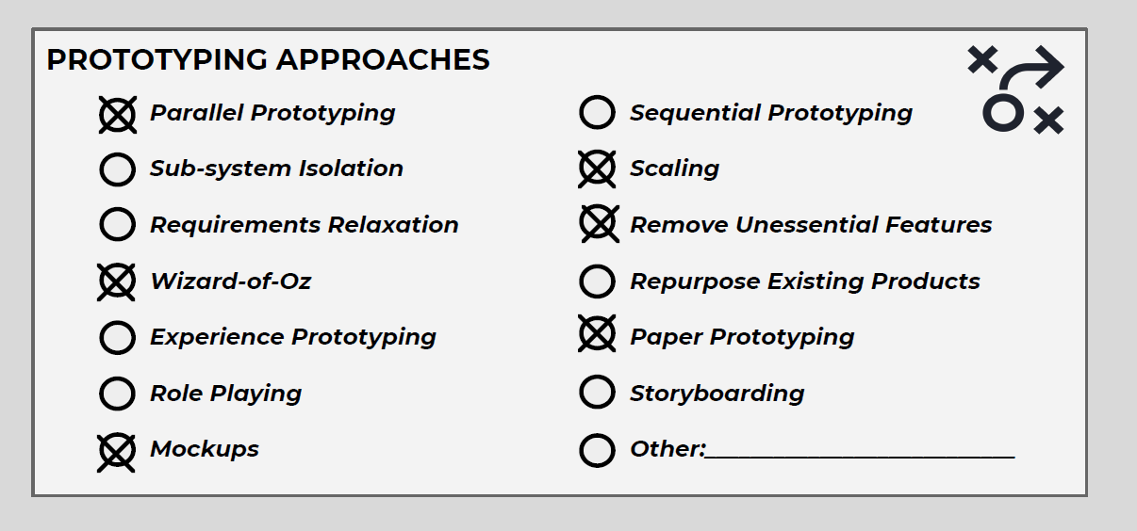
Prototyping Roadmap in Decision making
Notes:
We made use of the prototyping canvas to decide on some of our decisions. (Next slide)

Slide 26
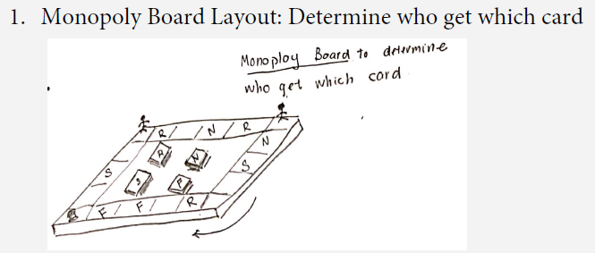
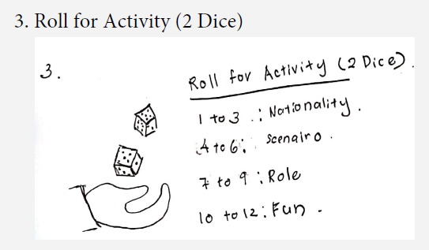
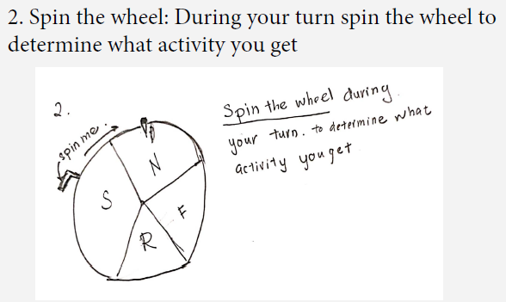
Activity Assignment Ideas
Notes:
For example, when deciding how to randomise movements, we came up 2 ideas. One was a spinning wheel activity selection using wizard of oz prototyping and the other was dice movement. However, moving the pieces across the board with dice increase the interaction the players had with the board. Thus we decided to use the dice to move along the board since there is increased engagement with the board

Slide 27
Difference between
Systems Design and
Detailed Design/Prototyping Phase
Notes:
So what are the differences between the systems design and detailed design?

Slide 28
Difference between Systems Design and
Detailed Design/Prototyping Phase
Player Interaction
Activity Provider
The Board
Notes:
We had 3 main difference: How players interacted with one another, what kind of activities were provided and what our board’s design was

Slide 29
Player Interaction
BEFORE:
We only came up with 1 player interaction at first where 1 player acts and another player guesses
Notes:
Firstly, our initial idea was to have only 1 player interaction where 1 player acts and another player guesses

Slide 30
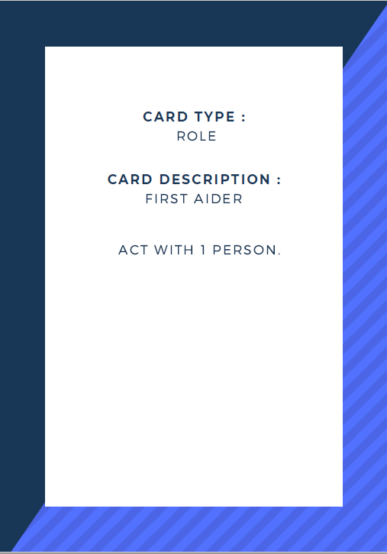
Player Interaction
AFTER
However, we found that it was more interesting if 2 player could act together
This made the game more interacting because it involve more players
Notes:
However, during the detailed design, we found that it was more interesting if 2 players acted together. This would enhance player to player interaction

Slide 31
Ending the game
BEFORE:
During our system definition, our initial plan was to end the game by finishing all the cards.
AFTER
During our prototyping phase, we realised gameplay might be too long.
Thus, we added an additional condition stating the game ends after a player accumulates 15 friends (Points)
Notes:
Reuben

Slide 32
Activity Provider
BEFORE:
In our system definition stage, we planned to have scenario cards where players can act out different scenarios
Notes:
Secondly, in our initial idea, we planned to have only 1 kind of activity which was the scenario cards, where players acted out different scenarios.

Slide 33
Activity Provider
AFTER
However, in our prototyping phase, we came up with the idea of splitting the cards into 4 different types of cards: Scenario, Role, Nationality and Fun
This would be more educational as it would impart more universal social knowledge and experience
Notes:
However, in our detailed design, we split our cards into 4 different types of cards: mainly the scenario, role, nationality and fun. This widen our educational value as players could learn more universal social interactions

Slide 34
Board
BEFORE:
During the system definition phase, our board was based on the game cluedo with different rooms of different nationality
Notes:
Lastly was our board design. Our initial idea was to have a board based on the game cluedo with different rooms that contained only different nationality

Slide 35
Board
AFTER
However, while prototyping, we realised this limited us to a few nationality
Thus, we transmitted into a monopoly style where more nationality could be played and every player had equal chances of playing each scenario
Notes:
However, this limited us to a few nationality. Thus, we decided to use a monopoly style board where we could introduce more nationality and each player would have an equal chance of playing each scenario

Slide 36
Overall Reflection on our Design Journey
Certain elements were discovered beyond the systems definition phase. Example: inclusion of fun cards and the layout of the cards
The objective our game remained the same throughout our design journey. However, the way we determined how players interact changed as we progress more into our detailed design
Notes:
In conclusion, we were able to introduce more elements beyond the system definition phase, such as the inclusion of different types of cards and the board layout. However, the objective of our game remained the same which was to impart social knowledge to our players.

Slide 37
Thank you for being part of our Journey

